Slide 1
Applying ML to Grow Vodacom Digital Services
Presented by The Meerkats 12 September 2018

Slide 2
Contents:
Introducing Team Meerkats
Vodacom Digital Services Background
Proposal – Target subscribers who might use this service
Models used
Results
Conclusion
What’s in it for Vodacom
Future Possibilities

Slide 3

Team Meerkats
David Gitahi
Jenifer Pedro
Thomas Lyimo
Willem Naudé

Slide 4





Vodacom Digital Services
Buy applications and digital services using Vodacom airtime or charged to monthly account
Current services available:
Shared revenue agreement with service providers
Subscriber don’t need credit cards to buy on digital platforms
Notes:
Vodacom benefit 2 fold – revenue and data download
Propensity Modelling
Modelling to identify customers who might take up or buy a specific product
Contact the right customers with the right offer to the right channel at the right time
Vodacom launced the digital contents initiative in Septemter 2017. The service amongst others include the ability to buy applications from sevices like Google Play and having the option to pay with airtime or get billed to your Vodacom contract.
The benefit to Vodacom is two-fold. There is a shared revenue agreement with the different service providers and as a result of purchasing and downlaoding apps data usage also increases.
Since its inception the digitial contents intiative has not used any advanced machine learning in or intelligent campaigns in order to target and expand this product offering and marketing this to new customers.
The purpose of this study is to determine if we are able to use machine learning and 3 months worth of historical data to train a model that will be able to predict and identify new customers to which Vodacom can expand and market the digital contents offering.
The scope of this project is focused on the Google Play service since that is where the most potential revenue lies. This can always be expanded to the other 8 digital channels like Netflix for example.

Slide 5
Revenue vs. Subscribers | Apple Store
500 k subscribers visited Apple Store since 1 Sept

Slide 6
Revenue vs. Subscribers | Google Play Store
7 Million subscribers visited Google Play since 1 Sept

Slide 7
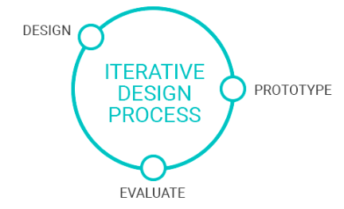
Modeling Approach
Dataset built up from 4 different sources
Digital Services, Data Usage, Voice Usage and Subscriber profile
MVP built on Logistic Regression
Recall was 53%
Settled on Random Forest with iterative parameter tuning
Recall was 55%
Notes:
Proves that customers are returning
However there’s not a lot of new customers.

Slide 8
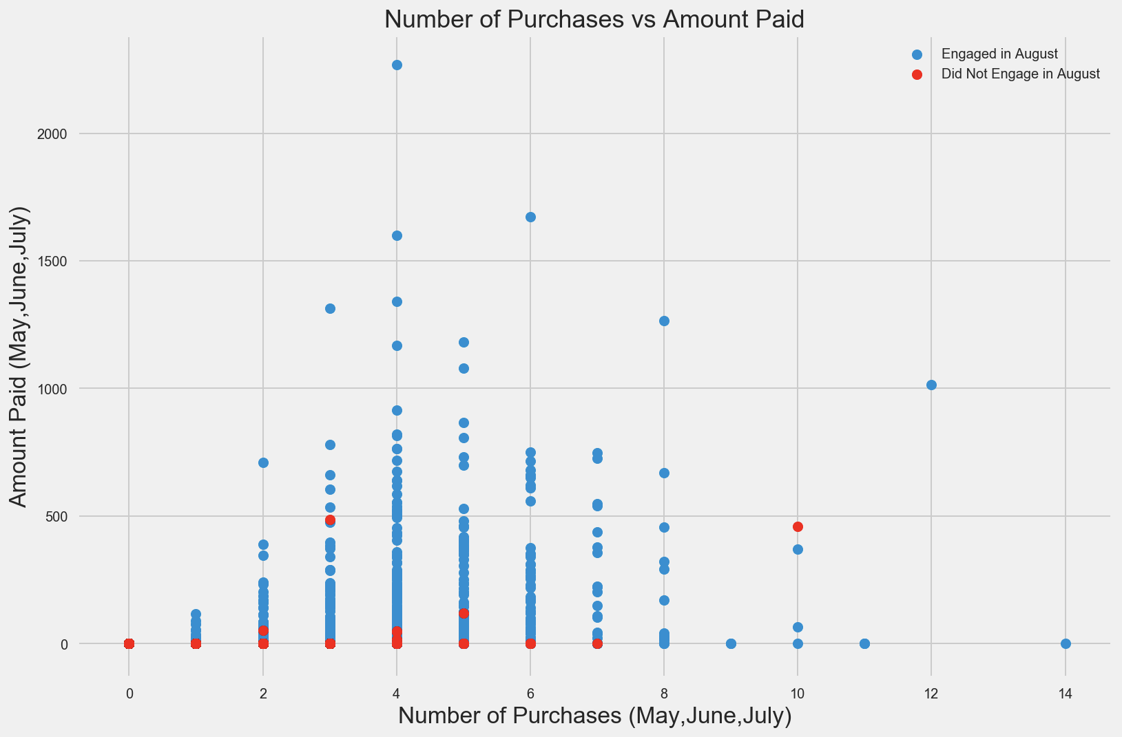
EDA | Insights
Notes:
Proves that customers are returning
However there’s not a lot of new customers.

Slide 9
Results| Model Defaulters Prediction
Predicted as Potential Buyers | 17%
Actual Buyers Predicted Correctly | 55%
Potential Buyers Predicted Wrongly | 45%

Slide 10
Results| Model Results

Slide 11
What’s in it for Vodacom?
Target: 5 Million subscribers
Take up: 150k spending avg. R3 p.m
Notes:
If we target 5 mil subs expecting a takeup of 3% which is 150000 subs
Spend R3 on average = R4500000 per month.

Slide 12

What’s in it for Vodacom?
R450 000 p.m = R5,4 mil per year
Notes:
If we target 5 mil subs expecting a takeup of 3% which is 150000 subs
Spend R3 on average = R4500000 per month.

Slide 13
Conclusion and Future Possibilities
Run model against other digital services i.e. Apple
Increase predicted revenue
Expand features to include:
Actual subscriber visits to the various app stores
Consider location information
ARPU
Marketing data mart – detailed customer spend
Upsell campaigns

Slide 14
Questions
?

Slide 15
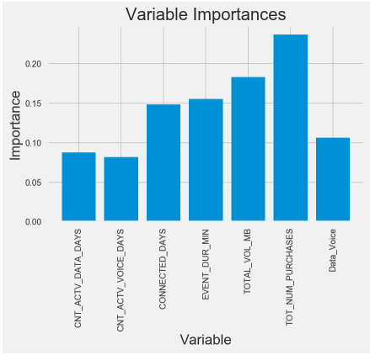
EDA | Insights

